Slide 1
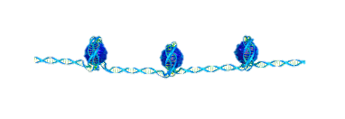
Properties of Chromatin Extracted by Salt Fractionation from both Cancerous and Non-cancerous Esophageal Cell Lines
Emily Luffey^{1,2}, Jiawei Liu^{1,2}, Nethmi Ariyasinghe^{1,2}, Subhadip Senapati^{1,2}, Stuart Lindsay ^{1,2,3}, Robert Ros^{1,2} ,Yang Jiao⁴
¹Department of Physics, ²Biodesign Institute, ³Department of Chemistry and Biochemistry, ⁴SEMTE, Arizona State University, Tempe, AZ 85287

Slide 2
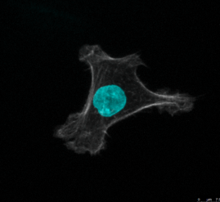
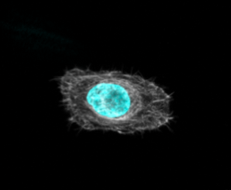
Motivation
The National Institute of Health estimates that approximately 38.4% of men and women will be diagnosed with cancer at some point during their lifetimes.[2]
Studies show that the more abnormal a particular cell nucleus is, the more aggressive a particular form of cancer is.[2]
Are there differences between the morphology of chromatin found in EPC2(Non-Cancerous) and CPD(Cancerous) cells?
Non-Cancerous (EPC2)
Cancerous (CPD)

Slide 3
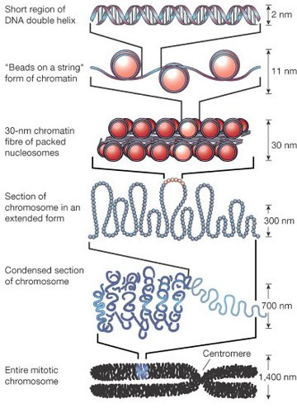
Background
A major variable in the overall nuclear structure is chromatin compaction and structure.
Studies show that Salt Fractionation is an efficient method for extracting intact chromatin. [1]
In this study, we propose to use a combination of salt fractionation and Atomic Force Microscopy (AFM) to characterize chromatin compaction and structure for both cancerous and non-cancerous Esophageal cell lines.
Alberts B, Bray D, Johnson A et al. (1997) Essential Cell Biology. London: Garland Publishing.

Slide 4
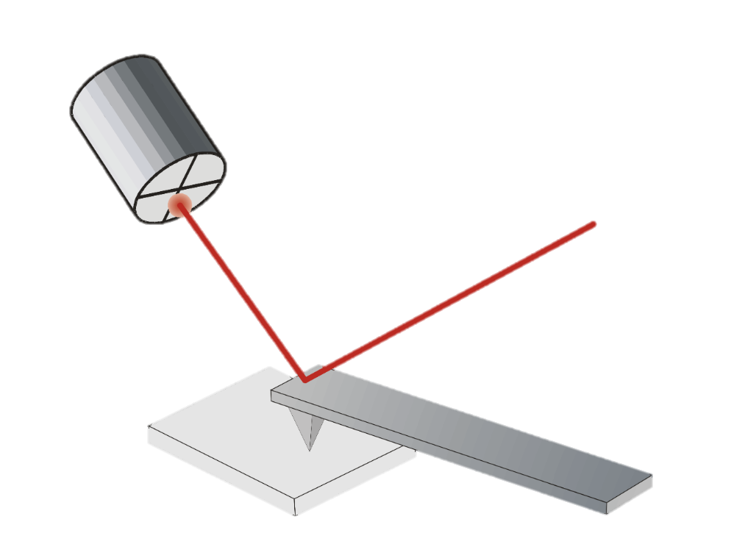
Experimental Design
Culture Cells
Extract Cellular Nuclei
Measure the Absorbance Spectra of DNA sample
DNA Extraction Using Chloroform/Ethanol Method
Chromatin Extraction Using Salt Fractionation
Supernatant
Low Salt
High Salt
Insoluble
(A)
(B)
(C)
(D)
Detector
Laser Beam
Cantilever
Sample
ETH Zurich, Laboratory for Multifunctional Ferroic Materials. “Scanning Probe Microscopy.

Slide 5
Results
CPD High Salt
EPC2 High Salt
CPD Low Salt
EPC2 Low Salt
2 min 4 min 8 min 16 min
Time Digested by Micrococcal Nuclease
*EPC2 (Noncancerous)
*CPD (Cancerous)

Slide 6
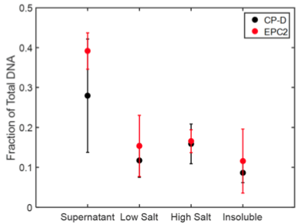
Results
CPD Supernatant
EPC2 Supernatant
2 min 4 min 8 min 16 min
Time Digested by Micrococcal Nuclease
*EPC2 (Noncancerous)
*CPD (Cancerous)

Slide 7
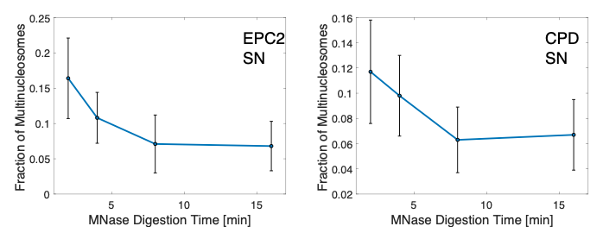
Analysis
EPC2 Supernatant
CP-D Supernatant
Used a lineal-path function for two-phase heterogeneous media adapted from [3].
Generated probability of finding a line segment of a certain length when randomly thrown into the sample.
Averaged results across all images taken for each fraction to find Fraction of Multinucleosomes.
*SN (Supernatant) *EPC2 (Noncancerous)
* Mnase (Micrococcal Nuclease) *CPD (Cancerous)

Slide 8
Conclusions
The Supernatant fraction, which has previously been neglected in literature[1], contains the largest quantity of DNA.
We have found significant differences in the chromatin morphology between CPD (cancerous) and EPC2 (non-cancerous).
We anticipate that our results will help to gain insight into the mechanisms of phenotypic change in cells from normal to cancerous.
Future work will include the addition of gel electrophoresis results, and correlation with differences in genes being expressed.

Slide 9
Thank You!
Acknowledgements
We would like to acknowledge Ben Miller for assistance with cell culture, chromatin extraction and helpful discussion, and James Faust for the confocal imaging of each cell line. The material contained in this document is based upon work supported by a National Aeronautics and Space Administration (NASA) grant or cooperative agreement. Any opinions, findings, conclusions or recommendations expressed in this material are those of the author and do not necessarily reflect the views of NASA. This work was supported through a NASA grant awarded to the Arizona/NASA Space Grant Consortium.
References
[1] Sanders MM. Fractionation of nucleosomes by salt elution from micrococcal nuclease-digested nuclei. Journal of Cell Biology, 79(1):97–109, 1978.
[2] Ariyasinghe, Nethmi. Biophysical Characterization of Cancer Cell Phenotypes. Arizona State University, PhD Dissertation, 2019.
[3] Lu, Binglin; Torquato, S, Lineal-path function for random heterogeneous materials. II. Effect of polydispersivity. ISSN: 1050-2947 ,1094-1622; DOI: 10.1103/PhysRevA.45.7292, Physical Review A , 1992, Vol.45(10), p.7292-7301

